Slide 1
Week 7-Cryptographic Hash Functions
Main resource: https://www.cpe.ku.ac.th/~nguan/class/204427-55/slides/01204427-Hash_Crypto.ppt

Slide 2
Topics
Overview of Cryptography Hash Function
Usages
Properties
Hashing Function Structure
Attack on Hash Function
The Road to new Secure Hash Standard

Slide 3
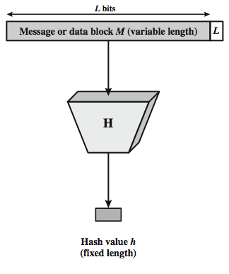

Hash Function
The hash value represents concisely the longer message
may called the message digest
A message digest is as a ``digital fingerprint'' of the original document
condenses arbitrary message to fixed size
h = H(M)
Notes:
A hash function H accepts a variable-length block of data M as input and produces a fixed-size hash value h = H(M). A "good" hash function has the property that the results of applying the function to a large set of inputs will produce outputs that are evenly distributed, and apparently random. In general terms, the principal object of a hash function is data integrity. A change to any bit or bits in M results, with high probability, in a change to the hash code. The kind of hash function needed for security applications is referred to as a cryptographic hash function. A cryptographic hash function is an algorithm for which it is computationally infeasible (because no attack is significantly more efficient than brute force) to find either (a) a data object that maps to a pre-specified hash result (the one-way property) or (b) two data objects that map to the same hash result (the collision-free property). Because of these characteristics, hash functions are often used to determine whether or not data has changed.
Stallings Figure 11.1 depicts the general operation of a cryptographic hash function. Typically, the input is padded out to an integer multiple of some fixed length (e.g., 1024 bits) and the padding includes the value of the length of the original message in bits. The length field is a security measure to increase the difficulty for an attacker to produce an alternative message with the same hash value.

Slide 4

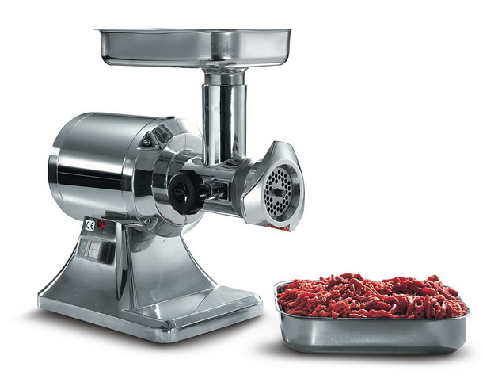
Chewing functions
Hashing function as “chewing” or “digest” function
Notes:
Hash functions, Tuma and properties.
One-wayness
First and second preimage resistance
Collision resistance
After a while he started to call them chewing functions
-->
So here we have some classic chewing functions

Slide 5
Hashing V.S. Encryption
Hello, world.
A sample sentence to show encryption.
k
E
NhbXBsZSBzZW50ZW5jZSB0byBzaG93IEVuY3J5cHRpb24KsZSBzZ
Hello, world.
A sample sentence to show encryption.
D
k
NhbXBsZSBzZW50ZW5jZSB0byBzaG93IEVuY3J5cHRpb24KsZSBzZ
Encryption is two way, and requires a key to encrypt/decrypt
This is a clear text that can easily read without using the key. The sentence is longer than the text above.
h
52f21cf7c7034a20 17a21e17e061a863
Hashing is one-way. There is no 'de-hashing’

Slide 6
Hash Functions: Main Idea
hash function H
.
message
“message
digest”
x
.
.
y
.
x’’
.
y’
x’
bit strings of any length
n-bit strings
Hash function H is a lossy compression function
Collision: H(x)=H(x’) for some inputs x≠x’
H(x) should look “random”
Every bit (almost) equally likely to be 0 or 1
A cryptographic secure hash function must have certain properties

Slide 7
Motivation for Hash Algorithms
Intuition
Limitation on non-cryptographic checksum
Very possible to construct a message that matches the checksum
Goal
Design a code where the original message can not be inferred based on its checksum
such that an accidental or intentional change to the message will change the hash value

Slide 8
Hash Function Applications
Used Alone
Fingerprint -- file integrity verification, public key fingerprint
Password storage (one-way encryption)
Combined with encryption functions
Hash based Message Authentication Code (HMAC)
protects both a message's integrity and confidentiality
Digital signature
Ensuring Non-repudiation
Encrypt hash with private (signing) key and verify with public (verification) key

Slide 9
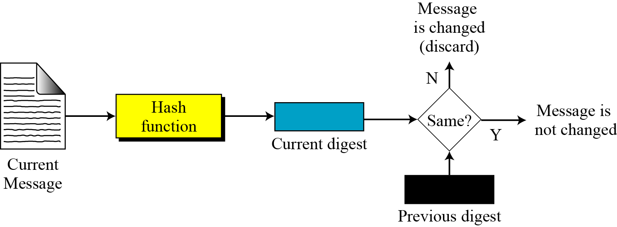
Integrity
to create a one-way password file
store hash of password not actual password
for intrusion detection and virus detection
keep & check hash of files on system
Notes:
Hash functions are commonly used to create a one-way password file. Chapter 20 explains a scheme in which a hash of a password is stored by an operating system rather than the password itself. Thus, the actual password is not retrievable by a hacker who gains access to the password file. In simple terms, when a user enters a password, the hash of that password is compared to the stored hash value for verification. This approach to password protection is used by most operating systems.
Hash functions can be used for intrusion detection and virus detection. Store H(F) for each file on a system and secure the hash values (e.g., on a CD-R that is kept secure). One can later determine if a file has been modified by recomputing H(F). An intruder would need to change F without changing H(F).
A cryptographic hash function can be used to construct a pseudorandom function (PRF) or a pseudorandom number generator (PRNG). A common application for a hash-based PRF is for the generation of symmetric keys. We discuss this application in Chapter 12.

Slide 10
Password Verification
Store Hashing Password
Verification an input password against the stored hash
Iam#4VKU
Iam#4VKU
Password store
h
h
661dce0da2bcb2d8 2884e0162acf8194
661dce0da2bcb2d8 2884e0162acf8194
661dce0da2bcb2d8 2884e0162acf8194
Hash Matching Exactly?
Password store
Yes
No
Grant
Deny

Slide 11
Topics
Overview of Cryptography Hash Function
Usages
Properties
Hashing Function Structure
Attack on Hash Function
The Road to new Secure Hash Standard

Slide 12
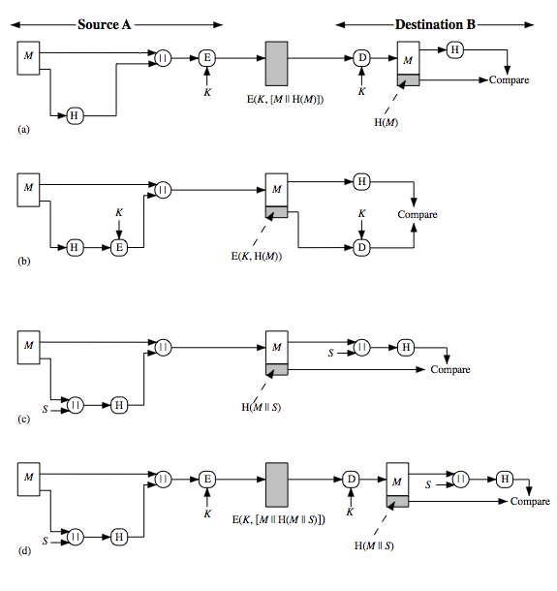
Hash Function Usages (I)
Message encrypted : Confidentiality and authentication
Message unencrypted: Authentication
Notes:
Message authentication is a mechanism or service used to verify the integrity of a message, by assuring that the data received are exactly as sent. Stallings Figure 11.2 illustrates a variety of ways in which a hash code can be used to provide message authentication, as follows:
The message plus concatenated hash code is encrypted using symmetric encryption. Since only A and B share the secret key, the message must have come from A and has not been altered. The hash code provides the structure or redundancy required to achieve authentication.
Only the hash code is encrypted, using symmetric encryption. This reduces the processing burden for those applications not requiring confidentiality.

Slide 13
Hash Function Usages (II)
Message encrypted : Authentication (no encryption needed!)
Message encrypted: Authentication, confidentiality
Notes:
(c) Shows the use of a hash function but no encryption for message authentication. The technique assumes that the two communicating parties share a common secret value S. A computes the hash value over the concatenation of M and S and appends the resulting hash value to M. Because B possesses S, it can recompute the hash value to verify. Because the secret value itself is not sent, an opponent cannot modify an intercepted message and cannot generate a false message.
(d) Confidentiality can be added to the approach of (c) by encrypting the entire message plus the hash code.
When confidentiality is not required, method (b) has an advantage over methods (a) and (d), which encrypts the entire message, in that less computation is required.

Slide 14
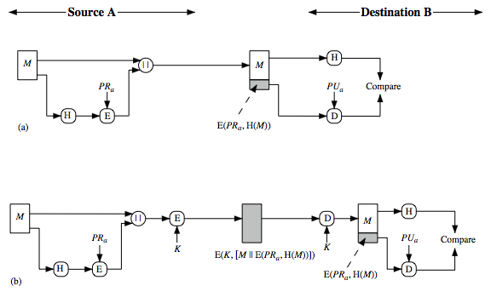
Hash Function Usages (III)
Authentication, digital signature
Authentication, digital signature, confidentiality
Notes:
Another important application, which is similar to the message authentication application, is the digital signature. The operation of the digital signature is similar to that of the MAC. In the case of the digital signature, the hash value of a message is encrypted with a user's private key. Anyone who knows the user's public key can verify the integrity of the message that is associated with the digital signature. In this case an attacker who wishes to alter the message would need to know the user's private key. As we shall see in Chapter 14, the implications of digital signatures go beyond just message authentication. Stallings Figure 11.3 illustrates, in a simplified fashion, how a hash code is used to provide a digital signature:
The hash code is encrypted, using public-key encryption and using the sender's private key. As with Figure 11.2b, this provides authentication. It also provides a digital signature, because only the sender could have produced the encrypted hash code. In fact, this is the essence of the digital signature technique.
If confidentiality as well as a digital signature is desired, then the message plus the private-key-encrypted hash code can be encrypted using a symmetric secret key. This is a common technique.

Slide 15
Topics
Overview of Cryptography Hash Function
Usages
Properties
Hashing Function Structure
Attack on Hash Function
The Road to new Secure Hash Standard

Slide 16
Hash Function Properties
Arbitrary-length message to fixed-length digest
Preimage resistant (One-way property)
Second preimage resistant (Weak collision resistant)
Collision resistant (Strong collision resistance)
Notes:
The first properties are requirements for the practical application of a hash function. The second property, preimage (for a hash value h = H(x), we say that x is the preimage of h) resistant, is the one-way property: it is easy to generate a code given a message, but virtually impossible to generate a message given a code. This property is important if the authentication technique involves the use of a secret value The fthird property, second preimage resistant, guarantees that it is impossible to find an alternative message with the same hash value as a given message. This prevents forgery when an encrypted hash code is used. If the fouth property, collision resistant, is also satisfied, then it is referred to as a strong hash function. A strong hash function protects against an attack in which one party generates a message for another party to sign. The final requirement, pseudorandomness, has not traditionally been listed as a requirement of cryptographic hash functions, but is more or less implied.

Slide 17
Security Requirements for Cryptographic Hash Functions
Given a function h:X →Y, then we say that h is:
preimage resistant (one-way):
if given y ∈Y it is computationally infeasible to find a value x ∈X s.t. h(x) = y
2-nd preimage resistant (weak collision resistant):
if given x ∈ X it is computationally infeasible to find a value x’ ∈ X, s.t. x’≠x and h(x’) = h(x)
collision resistant (strong collision resistant):
if it is computationally infeasible to find two distinct values x’,x ∈ X, s.t. h(x’) = h(x)

Slide 18
Properties : Fixed length
Hello, world
h
661dce0da2bcb2d8 2884e0162acf8194
Fixed length L
This is a clear text that can easily read without using the key. The sentence is longer than the text above.
h
52f21cf7c7034a20 17a21e17e061a863
Arbitrary-length message to fixed-length digest

Slide 19
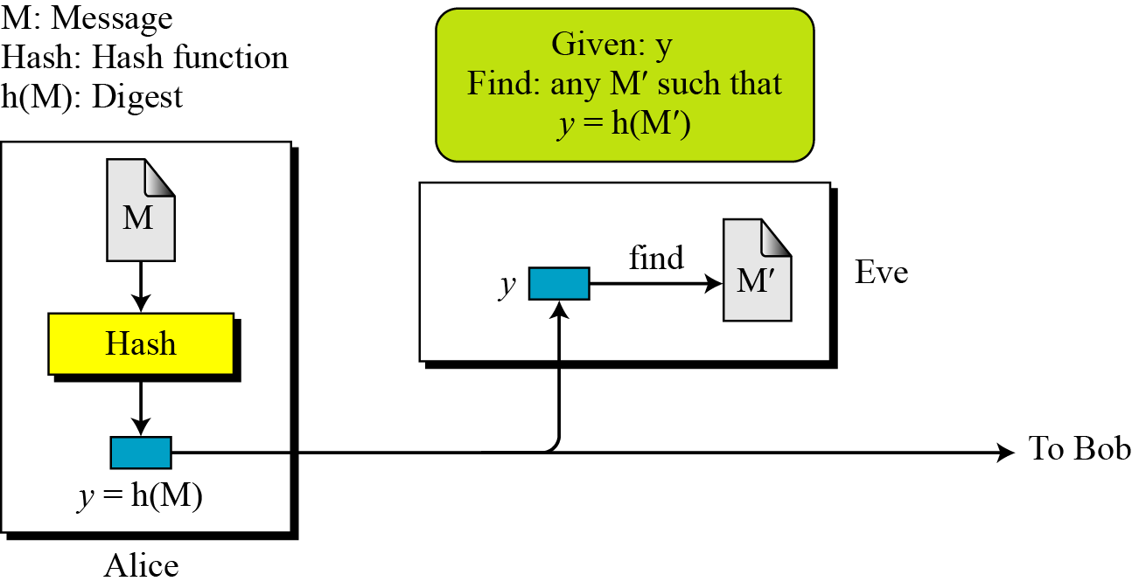
Preimage resistant (one-way)
This measures how difficult to devise a message which hashes to the known digest
Roughly speaking, the hash function must be one-way.
Given only a message digest, can’t find any message (or preimage) that generates that digest.
Notes:
Exploiting weak preimage resistance: If we are able to "work backwards" from a hash and create some text that produces the same hash, we can use this to beat hashed passwords. We won't ever know the actual input data that was used, but that doesn't matter.Looking at the flow for validating against hashed passwords, all that matters is that the hashes match, not the passwords, so if we can findany other text that produces the stored hash, we'll be granted access. "Collisions" mean "more than one password will be accepted".

Slide 20
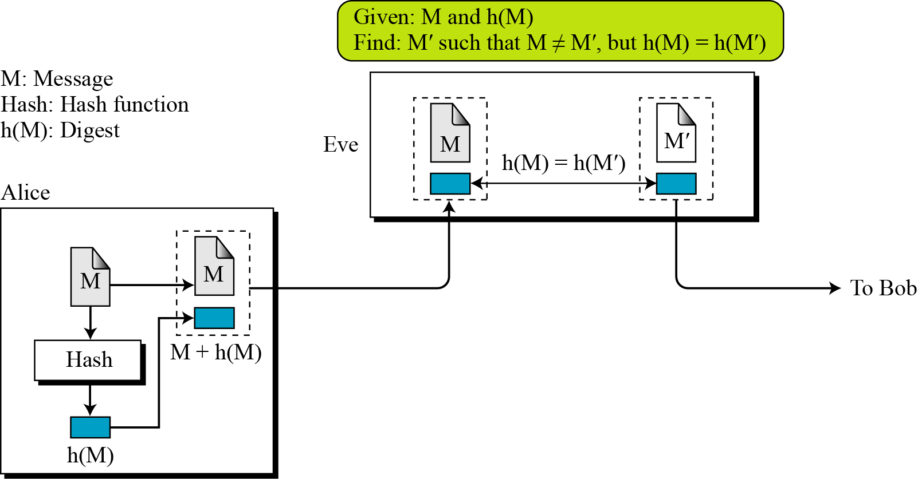
Second preimage resistant (weak collision resistant)
This measures how difficult to devise a message which hashes to the known digest and its message
Given one message, can’t find another message that has the same message digest. An attack that finds a second message with the same message digest is a second pre-image attack.
It would be easy to forge new digital signatures from old signatures if the hash function used weren’t second preimage resistant
Notes:
This seems like a somewhat easier case of the previous item: the goal is to produce a new input that generates the given hash, but this time we know the original text that created it. Exploiting second weak preimage resistance: As with preimage resistance, we want to fool somebody into authenticating our data as genuine, and we'd most likely use this when trying to introduce a corrupted software distribution.We saw that many other organizations publishes software and matching md5 checksums, and if we are able to maliciously modify the source code but nevertheless keep the same checksum, downloaders around the globe will accept badware as genuine.

Slide 21
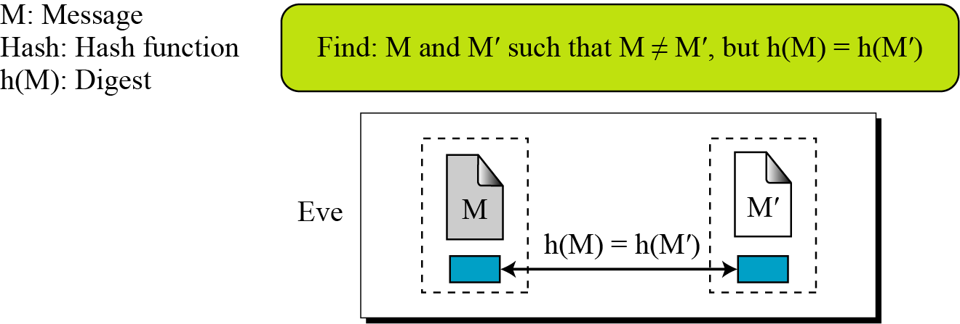
Collision Resistant (strong collision resistant)
Can’t find any two different messages with the same message digest
Collision resistance implies second preimage resistance
Collisions, if we could find them, would give signatories a way to repudiate their signatures

Slide 22
Topics
Overview of Cryptography Hash Function
Usages
Properties
Hashing Function Structure
Attack on Hash Function
The Road to new Secure Hash Standard

Slide 23
Two Group of Compression Functions
The compression function is made from scratch
Message Digest: a numeric representation of a message computed by a cryptographic hash algorithm or a function.
A symmetric-key block cipher serves as a compression function
Whirlpool: Whirlpool is a hash designed after the Square block cipher, and is considered to be in that family of block cipher functions.

Slide 24
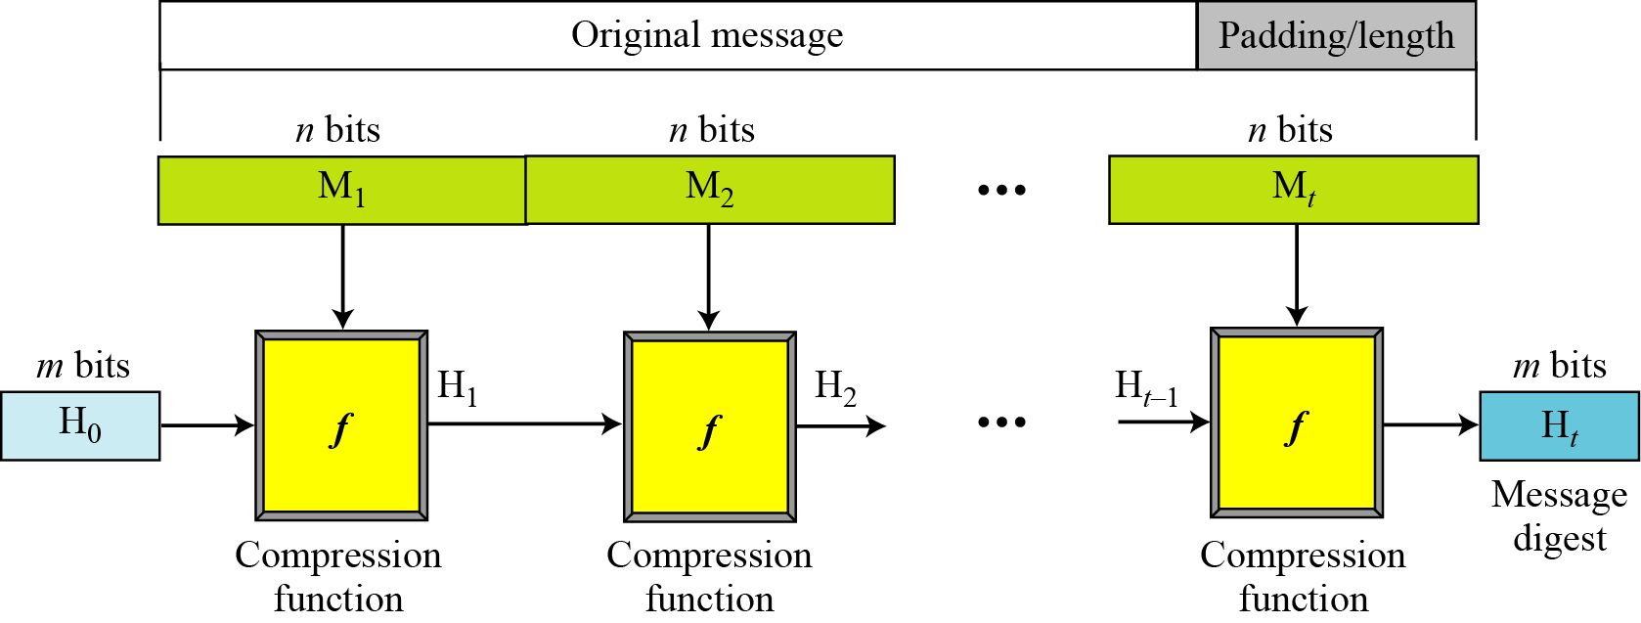
Merkle-Damgard Scheme
Well-known method to build cryptographic hash function
A message of arbitrary length is broken into blocks
length depends on the compression function f
padding the size of the message into a multiple of the block size.
sequentially process blocks , taking as input the result of the hash so far and the current message block, with the final fixed length output
Used in MD5, SHA-1 and SHA-2.
Notes:
Damgard and Merkle greatly influenced cryptographic hash function design by defining a hash function in terms of what is called a compression function.
A compression function takes a fixed-length input and returns a shorter, fixed-length output.
Given a compression function, a hash function can be defined by repeated applications of the compression function until the entire message has been processed.
Take a long message, break it into blocks
M₁, M₂, M₃…M_{k} (pad out last block)
Let f be a “compression function” that operates on a block and the current h-bit state and “mixes” the block into the state
Last output of compression function is the h-bit message digest.
The Merkle–Damgård construction was described in Ralph Merkle's Ph.D. thesis in 1979.^{[2]} Ralph Merkle and Ivan Damgård independently proved that the structure is sound: that is, if an appropriate padding scheme is used and the compression function is collision-resistant, then the hash function will also be collision-resistant

Slide 25
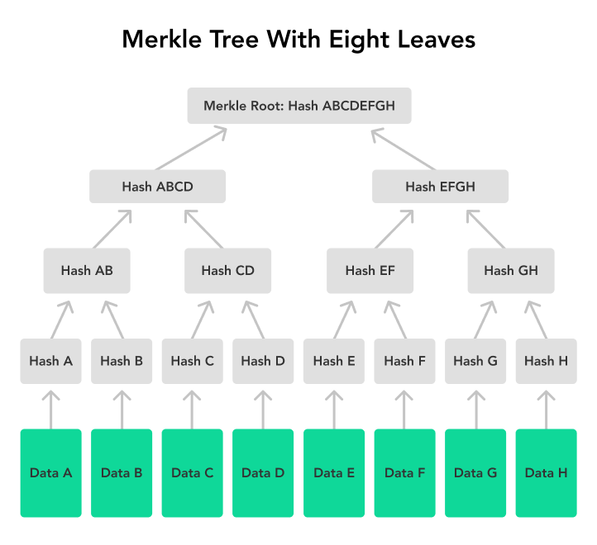
Merkle Tree: in Bitcoin Structure
In the Bitcoin network, all the transactions inside a block are summarized in a Merkle tree by producing a digital fingerprint of the entire set of transactions.
This way a user is able to verify whether a transaction is included in a block or not.
In the Bitcoin network, Merkle trees are used for data verification, which is efficient because hashes are used instead of a complete information file

Slide 26
Hash Functions Family
MD (Message Digest)
Designed by Ron Rivest
Family: MD2, MD4, MD5
SHA (Secure Hash Algorithm)
Designed by NIST
Family: SHA-0, SHA-1, and SHA-2
SHA-2: SHA-224, SHA-256, SHA-384, SHA-512
SHA-3: New standard in competition
RIPEMD (Race Integrity Primitive Evaluation Message Digest)
Developed by Katholieke University Leuven Team
Family : RIPEMD-128, RIPEMD-160, RIPEMD-256, RIPEMD-320

Slide 27
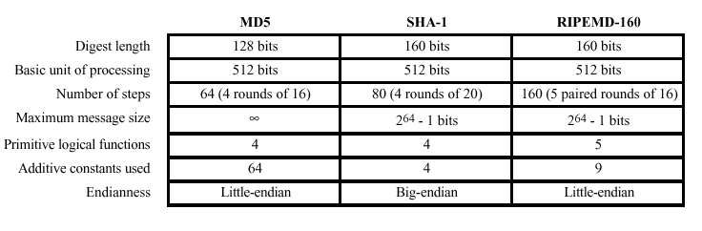
MD5, SHA-1, and RIPEMD-160

Slide 28
MD2, MD4 and MD5
Family of one-way hash functions by Ronald Rivest
All produces 128 bits hash value
MD2: 1989
Optimized for 8 bit computer
Collision found in 1995
MD4: 1990
Full round collision attack found in 1995
MD5: 1992
Specified as Internet standard in RFC 1321
since 1997 it was theoretically not so hard to create a collision
Practical Collision MD5 has been broken since 2004
CA (collision attack) attack published in 2007

Slide 29
Topics
Overview of Cryptography Hash Function
Usages
Properties
Hashing Function Structure
MD5
SHA
Attack on Hash Function
The Road to new Secure Hash Standard

Slide 30
MD5 Overview
The MD5 message-digest algorithm is a widely used hash function producing a 128-bit hash value.
MD5 was designed by Ronald Rivest in 1991 to replace an earlier hash function MD4, and was specified in 1992 as RFC 1321.
MD5 can be used as a checksum to verify data integrity against unintentional corruption.
Historically it was widely used as a cryptographic hash function; however it has been found to suffer from extensive vulnerabilities.

Slide 31
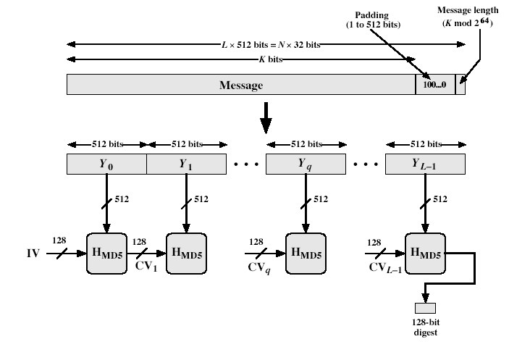
MD5 Overview
Notes:
Stallings Fig 12.1

Slide 32
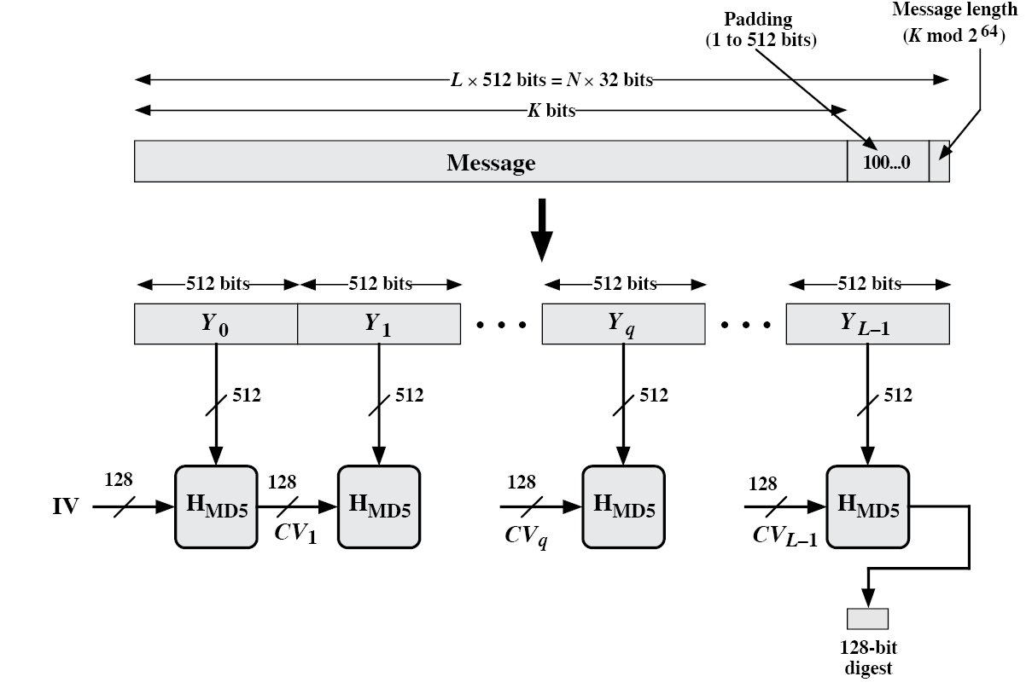
MD5 Overview
2. Append length (64bits)
1. Append padding bits
(to 448 mod 512)
3. Initialize MD buffer (4x32 bits Word)
Word A = 01 23 45 67
Word B = 89 AB CD EF
Word C = FE DC BA 98
Word D = 76 54 32 10

Slide 33
Hash Algorithm Design – MD5
16 steps
X[k] = M [q*16+k] (32 bit)
Constructed from sine function

Slide 34
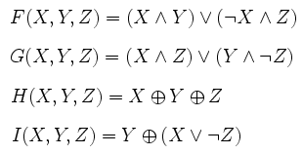
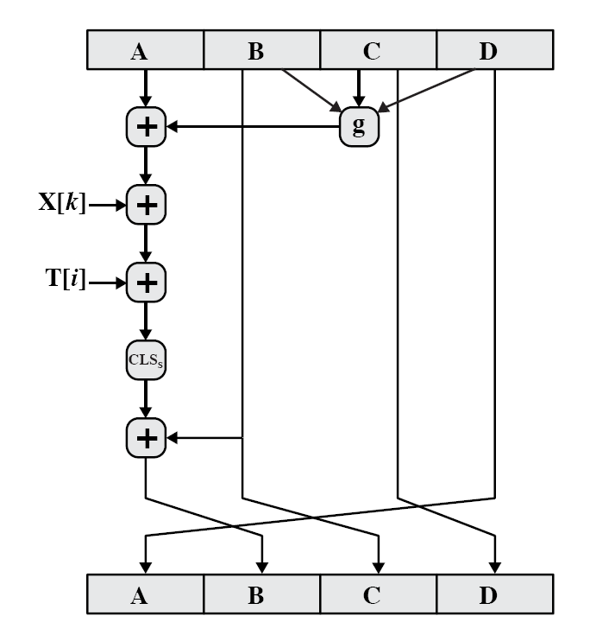
The ith 32-bit word in matrix T, constructed from the sine function
M [q*16+k] = the kth 32-bit word from the qth 512-bit block of the msg
Single step

Slide 35
Topics
Overview of Cryptography Hash Function
Usages
Properties
Hashing Function Structure
MD5
SHA
Attack on Hash Function
The Road to new Secure Hash Standard

Slide 36
Secure Hash Algorithm (SHA)
SHA originally designed by NIST & NSA in 1993
revised in 1995 as SHA-1
US standard for use with DSA signature scheme
standard is FIPS 180-1 1995, also Internet RFC3174
based on design of MD4 with key differences
produces 160-bit hash values
recent 2005 results on security of SHA-1 have raised concerns on its use in future applications
Notes:
In recent years, the most widely used hash function has been the Secure Hash Algorithm (SHA). The Secure Hash Algorithm (SHA) was developed by the National Institute of Standards and Technology (NIST) and published as a federal information processing standard (FIPS 180) in 1993; a revised version was issued as FIPS 180-1 in 1995 and is generally referred to as SHA-1. The actual standards document is entitled Secure Hash Standard. SHA is based on the hash function MD4 and its design closely models MD4. SHA-1 produces a hash value of 160 bits. In 2005, a research team described an attack in which two separate messages could be found that deliver the same SHA-1 hash using 2^69 operations, far fewer than the 2^80 operations previously thought needed to find a collision with an SHA-1 hash [WANG05]. This result has hastened the transition to newer, longer versions of SHA.

Slide 37
Revised SHA (SHA-2)
NIST issued revision FIPS 180-2 in 2002
adds 3 additional versions of SHA
SHA-256, SHA-384, SHA-512
designed for compatibility with increased security provided by the AES cipher
structure & detail is similar to SHA-1
hence analysis should be similar
but security levels are rather higher
Notes:
In 2002, NIST produced a revised version of the standard, FIPS 180-2, that defined three new versions of SHA, with hash value lengths of 256, 384, and 512 bits, known as SHA-256, SHA-384, and SHA-512. Collectively, these hash algorithms are known as SHA-2. These new versions have the same underlying structure and use the same types of modular arithmetic and logical binary operations as SHA-1, hence analyses should be similar. A revised document was issued as FIP PUB 180-3 in 2008, which added a 224-bit version. SHA-2 is also specified in RFC 4634, which essentially duplicates the material in FIPS 180-3, but adds a C code implementation.
In 2005, NIST announced the intention to phase out approval of SHA-1 and move to a reliance on the other SHA versions by 2010.

Slide 38
SHA Versions
 | MD5 | SHA-0 | SHA-1 | SHA-224 | SHA-256 | SHA-384 | SHA-512
Digest size | 128 | 160 | 160 | 224 | 256 | 384 | 512
Message size | 2⁶⁴-1 | 2⁶⁴-1 | 2⁶⁴-1 | 2⁶⁴ -1 | 2⁶⁴-1 | 2¹²⁸-1 | 2¹²⁸-1
Block size | 512 | 512 | 512 | 512 | 512 | 1024 | 1024
Word size | 32 | 32 | 32 | 32 | 32 | 64 | 64
# of steps | 64 | 64 | 80 | 64 | 64 | 80 | 80
Full collision found
Notes:
Stallings Table 11.3 provides a comparison of the various parameters for the SHA hash functions.

Slide 39
Sample Processing
Type bits data processed
MD5 128 469.7 MB/s
SHA-1 160 339.4 MB/s
SHA-512 512 177.7 MB/s
Mac Intel 2.66 Ghz core i7
1024 bytes block of data

Slide 40
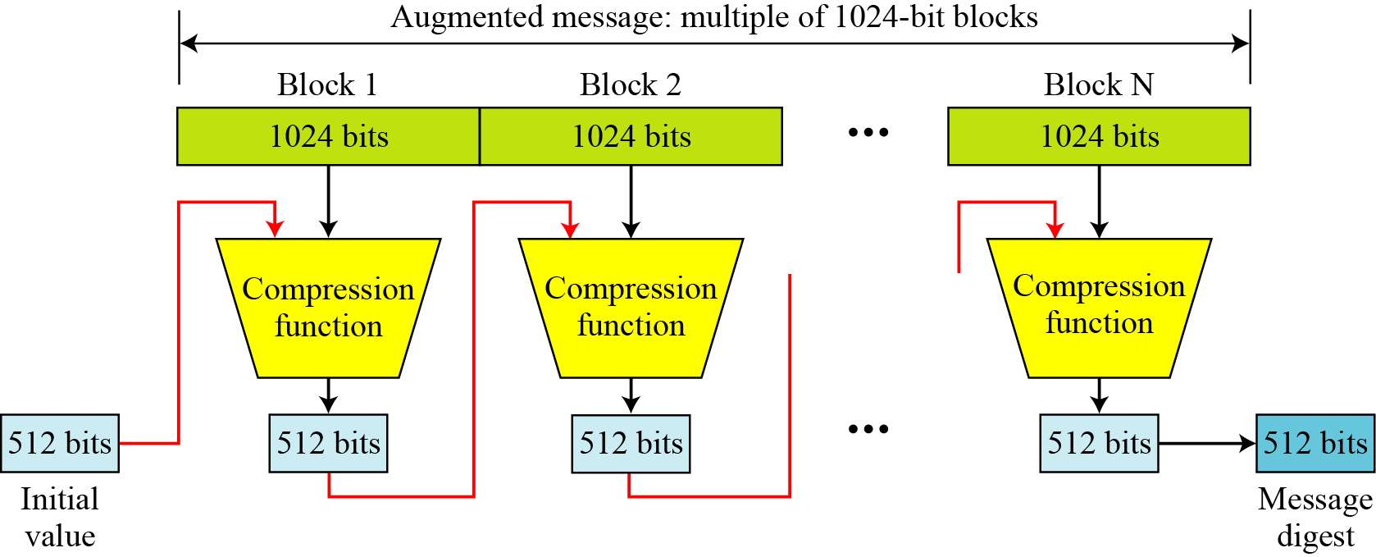
SHA-512 Overview
Notes:
Now examine the structure of SHA-512, noting that the other versions are quite similar.
SHA-512 follows the structure depicted in Stallings Figure 11.8. The processing consists of the following steps:
• Step 1: Append padding bits, consists of a single 1-bit followed by the necessary number of 0-bits, so that its length is congruent to 896 modulo 1024
• Step 2: Append length as an (big-endian) unsigned 128-bit integer
• Step 3: Initialize hash buffer to a set of 64-bit integer constants (see text)
• Step 4: Process the message in 1024-bit (128-word) blocks, which forms the heart of the algorithm. Each round takes as input the 512-bit buffer value H_{i}, and updates the contents of that buffer.
• Step 5: Output the final state value as the resulting hash
See text for more details.

Slide 41
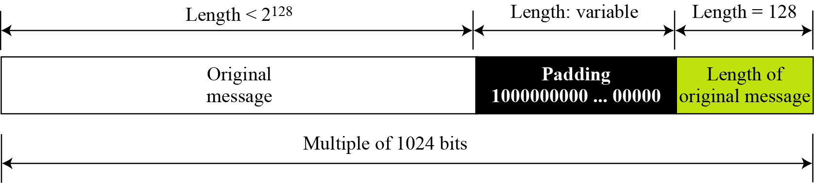
Padding and length field in SHA-512
What is the number of padding bits if the length of the original message is 2590 bits?
We can calculate the number of padding bits as follows:
The padding consists of one 1 followed by 353 0’s.

Slide 42
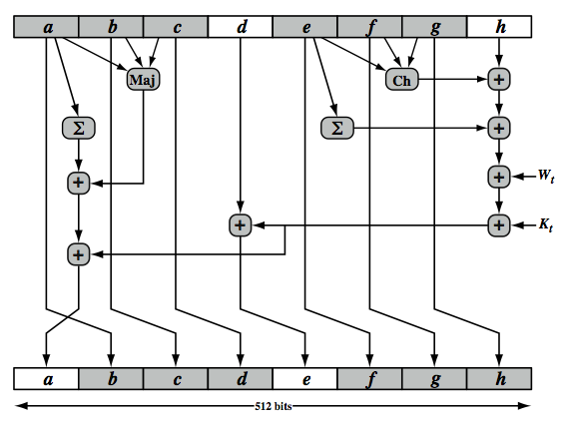
SHA-512 Round Function
Notes:
The structure of each of the 80 rounds is shown in Stallings Figure 11.10. Each 64-bit word is shuffled along one place, and in some cases manipulated using a series of simple logical functions (ANDs, NOTs, ORs, XORs, ROTates), in order to provide the avalanche & completeness properties of the hash function. The elements are:
Ch(e,f,g) = (e AND f) XOR (NOT e AND g)
Maj(a,b,c) = (a AND b) XOR (a AND c) XOR (b AND c)
∑(a) = ROTR(a,28) XOR ROTR(a,34) XOR ROTR(a,39)
∑(e) = ROTR(e,14) XOR ROTR(e,18) XOR ROTR(e,41)
+ = addition modulo 2^64
Kt = a 64-bit additive constant
Wt = a 64-bit word derived from the current 512-bit input block.
Six of the eight words of the output of the round function involve simply permutation (b, c, d, f, g, h) by means of rotation. This is indicated by shading in Figure 11.10. Only two of the output words (a, e) are generated by substitution. Word e is a function of input variables d, e, f, g, h, as well as the round word W t and the constant Kt. Word a is a function of all of the input variables, as well as the round word W t and the constant Kt.

Slide 43
Topics
Overview of Cryptography Hash Function
Usages
Properties
Hashing Function Structure
MD5
SHA
Attack on Hash Function
The Road to new Secure Hash Standard

Slide 44
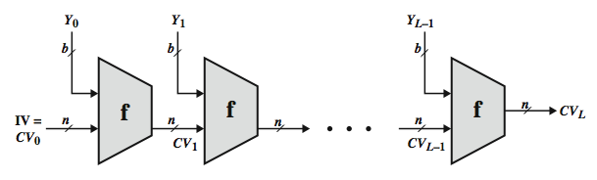
Hash Function Cryptanalysis
cryptanalytic attacks exploit some property of algorithm so faster than exhaustive search
hash functions use iterative structure
process message in blocks (incl length)
attacks focus on collisions in function f
Merkle and Damgard says that if the compression function is collision resistant, then so is the resultant iterated hash function
Notes:
As with encryption algorithms, cryptanalytic attacks on hash functions seek to exploit some property of the algorithm to perform some attack other than an exhaustive search. In recent years, have much effort, and some successes, in developing cryptanalytic attacks on hash functions. Must consider the overall structure of a typical secure hash function, referred to as an iterated hash function, as indicated in Stallings Figure 11.7. This was proposed by Merkle and is the structure of most hash functions in use today. The hash function takes an input message and partitions it into L fixed-sized blocks of b bits each. If necessary, the final block is padded to b bits. The final block also includes the value of the total length of the input to the hash function. The inclusion of the length makes the job of the opponent more difficult. The hash algorithm involves repeated use of a compression function, f, that takes two inputs (an n-bit input from the previous step, called the chaining variable, and a b-bit block) and produces an n-bit output. At the start of hashing, the chaining variable has an initial value that is specified as part of the algorithm. The final value of the chaining variable is the hash value. Often, b > n; hence the term compression. The motivation for this iterative structure stems from the observation by Merkle and Damgard that if the compression function is collision resistant, then so is the resultant iterated hash function. Therefore, the structure can be used to produce a secure hash function to operate on a message of any length. Cryptanalysis of hash functions focuses on the internal structure of f and is based on attempts to find efficient techniques for producing collisions for a single execution of f. Once that is done, the attack must take into account the fixed value of IV. The attack on f depends on exploiting its internal structure. The attacks that have been mounted on hash functions are rather complex and beyond our scope here.

Slide 45
Attacks on Hash Functions
brute-force attacks and cryptanalysis
cryptanalytic attacks exploit some property of algorithm so faster than brute-force
a preimage or second preimage attack
find y such that H(y)equals a given hash value
collision resistance
find two messages x & y with same hash so H(x) = H(y)
"md5 and sha1 are both clearly broken (in terms of collision-resistance”
Ron Rivest
http://mail.python.org/pipermail/python-dev/2005-December/058850.html
Notes:
As with encryption algorithms, there are two categories of attacks on hash functions: brute-force attacks and cryptanalysis. A brute-force attack does not depend on the specific algorithm but depends only on bit length. In the case of a hash function, a brute-force attack depends only on the bit length of the hash value. A cryptanalysis, in contrast, is an attack based on weaknesses in a particular cryptographic algorithm.
For a preimage or second preimage attack, an adversary wishes to find a value y such that H(y) is equal to a given hash value h. The brute force method is to pick values of y at random and try each value until a collision occurs. For an m-bit hash value, the level of effort is proportional to 2^{m}. Specifically, the adversary would have to try, on average, 2^{m–1} values of y to find one that generates a given hash value h.
For a collision resistant attack, an adversary wishes to find two messages or data blocks, x and y, that yield the same hash function: H(x) = H(y). This requires much less effort than a preimage or second preimage attack. The effort required is explained by a mathematical result referred to as the birthday paradox (next slide).
If collision resistance is required, then the value 2^{m/2} determines the strength of the hash code against brute-force attacks. Van Oorschot and Wiener presented a design for a $10 million collision search machine for MD5, which has a 128-bit hash length, that could find a collision in 24 days. Thus a 128-bit code may be viewed as inadequate. The next step up, if a hash code is treated as a sequence of 32 bits, is a 160-bit hash length. With a hash length of 160 bits, the same search machine would require over four thousand years to find a collision. With today's technology, the time would be much shorter, so that 160 bits now appears suspect.

Slide 46


Hash Function Weaknesses
Pigeonhole Principle
The Birthday Paradox
Notes:
To understand the possible exploitation of hash functions, there are two concepts we need to discuss: the pigeonhole principle and the birthday paradox.

Slide 47
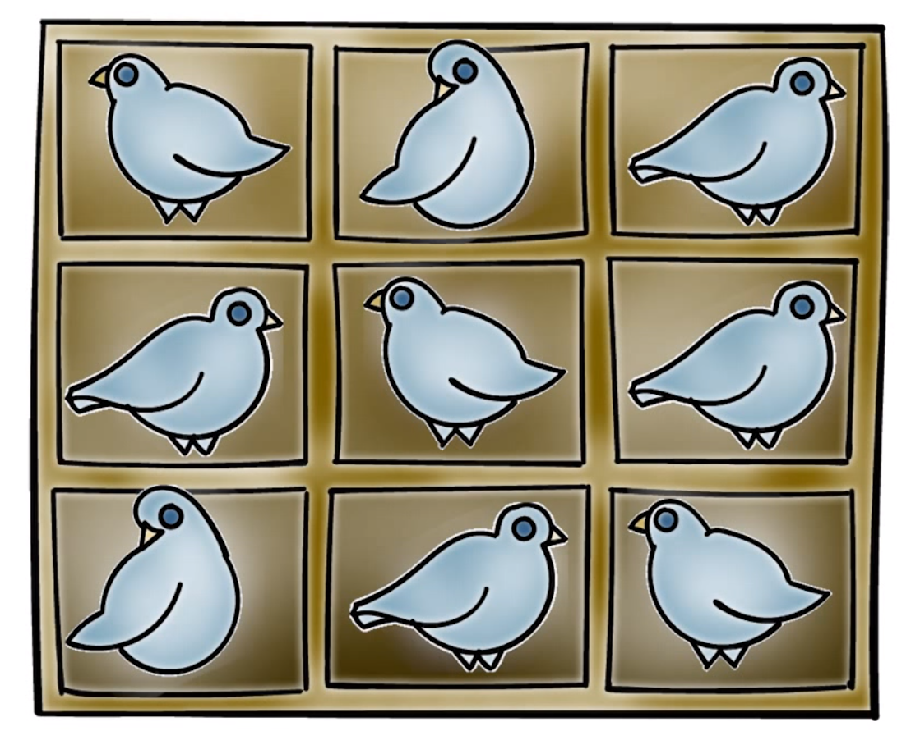
Hash Function Weaknesses
Pigeonhole Principle
n = number of pigeons
m = number of holes
n = m There is one pigeon per hole
n > m Then at least one hole must have more than one pigeon
Notes:
Imagine you have are 9 pigeonholes
----
If we have 9 pigeons, one pigeon can be placed in each hole.
----
If we add another pigeon, there will be one box with two pigeons.
n = number of pigeons
m = number of holes
n = m There is one pigeon per hole
n > m Then at least one hole must have more than one pigeon
We can generalize and say…
Anytime we have n items to put in m containers, if n > m, then at least one container must have more than one item

Slide 48
Hash Function Weaknesses
The Birthday Paradox
How many people do you need in a room before you have a greater than 50% chance that two of them will have the same birthday?
Assume 365 birthdays (our containers)
% chance that two people in the room have the same birthday:
100% requires 366 people (the pigeonhole principle)
Notes:
Let’s apply the Pigeonhole principle to another problem. How many people do you need in a room before you have a greater than 50% chance that you’d find two of them sharing the same birthday?
Assume we have 365 birthdays, our containers. To achieve 100% chance that two people share the same birthday we would need 366 people to be in the room.

Slide 49
Hash Function Weaknesses
The Birthday Paradox
Compute probability of different birthdays
Random sample of n people (birthdays) taken from k (365) days
k^{n} all cases
(k)_{n}=k(k-1)…(k-n+1) cases of different birthdays
Probability of repetition:
p = 1- (k)_{n}/k^{n} ≈ n(n-1)/2k = 0.5 if n=√k
Notes:
We can solve the problem using the following algorithm:
Compute probability of different birthdays
Random sample of n people (birthdays) taken from k (365) days
k^{n} samples with replacement
(k)_{n}=k(k-1)…(k-n+1) sample without replacement
Probability of repetition:
p = 1- (k)_{n}/k^{n} ≈ n(n-1)/2k = 0.5 if n=√k
This is an approximation

Slide 50
Hash Function Weaknesses
The Birthday Paradox
1-(k)_{n}/k^{n}= the probability that a pair share the same birthday
If k = 365, n = 19
If there are 19 people in a room, there is a good chance that two of them share the same birthday!
Notes:
Thus, if k=365, then n = 19. That is, if have more than 19 people in a room, there is a very good chance that two of them share the same birthday.
I have tried this in my class every year, with my students in the classroom, and it always works as the math tells us!

Slide 51
Hash Function Weaknesses
Hash Functions:
There are many more ‘pigeons’ than ‘pigeonholes’
Many inputs will be mapped to the same output. That is, many input messages will have the same hash.
Conclusion: The longer the length of the hash, the fewer collisions.
Notes:
Some of these properties seem to contradict each other.
In particular, since the input can be any length and the output is of fixed length, this means that there are many more, in fact infinitely more, possible inputs that are mapped to a fixed number of outputs. Therefore, many inputs will be mapped to the same output. That is, many input messages will have the same hash.
But the collision free property says that it should be computationally infeasible to find two different input messages that have the same hash. How can this be accomplished? Obviously, the larger the number of possible output hash values, the harder to find a collision. In other words, the longer the length of the output hash value, the better.
They only say that it should be compositionally in feasible to find two different messages that have the same hash value. It did not say that it should be mathematically impossible to find such collision.
But how long is sufficient to make it computationally infeasible to find collision?

Slide 52
Determining Hash Length
Notes:
Obviously, the larger the number of possible output hash values, the harder it is to find the collision. In other words, the longer the length of the output hash value, the better. In short, to avoid collision, we should use longer hash values
So now, let’s turn our attention to our original problem: how many bits should a hash have so that it is computationally infeasible to find two different messages that have the same hash?
Suppose the hash has l bits, then there are 2^l possible hash values, and according to the result from the Birthday Paradox we just discussed, if an attacker tries square root of 2^l, that is, 2^(l/2), that many messages, he has a good chance of finding a hash collision.
If the hash value only has 64 bits, that means that attacker only needs to try 2^(32) messages, which is quite feasible with today’s computing power.
Therefore, we need to use longer hash value in order to achieve hash resistance. We should use at least 128 bits.

Slide 53
Topics
Overview of Cryptography Hash Function
Usages
Properties
Hashing Function Structure
MD5
SHA
Attack on Hash Function
The Road to new Secure Hash Standard

Slide 54
The need of new Hash standard
MD5 should be considered cryptographically broken and unsuitable for further use, US CERT 2010
In 2004, a collision for the full SHA-0 algorithm was announced
SHA-1 not yet fully “broken”
but similar to the broken MD5 & SHA-0
so considered insecure and be fade out
SHA-2 (esp. SHA-512) seems secure
shares same structure and mathematical operations as predecessors so have concern
Notes:
As yet, SHA-1 has not yet been "broken". That is, no one has demonstrated a technique for producing collisions in less than brute-force time. However, because SHA-1 is very similar in structure and in the basic mathematical operations used to MD5 and SHA-0, both of which have been broken, SHA-1 is considered insecure and has been phased out for SHA-2.
SHA-2, particularly the 512-bit version, would appear to provide unassailable security. However, SHA-2 shares the same structure and mathematical operations as its predecessors, and this is a cause for concern. Because it will take years to find a suitable replacement for SHA-2, should it become vulnerable, NIST decided to begin the process of developing a new hash standard. Accordingly, NIST announced in 2007 a competition to produce the next generation NIST hash function, to be called SHA-3. NIST would like to have a new standard in place by the end of 2012, but emphasizes that this is not a fixed timeline.

Slide 55
SHA-3 Requirements
NIST announced in 2007 a competition for the SHA-3 next gen hash function
Replace SHA-2 with SHA-3 in any use
so use same hash sizes
preserve the nature of SHA-2
so must process small blocks (512 / 1024 bits)
evaluation criteria
security close to theoretical max for hash sizes
cost in time & memory
characteristics: such as flexibility & simplicity
Notes:
The basic requirements that must be satisfied by any candidate for SHA-3 are:
It must be possible to replace SHA-2 with SHA-3 in any application by a simple drop-in substitution. Therefore, SHA-3 must support hash value lengths of 224, 256, 384, and 512 bits.
SHA-3 must preserve the online nature of SHA-2. That is, the algorithm must process comparatively small blocks (512 or 1024 bits) at a time instead of requiring that the entire message be buffered in memory before
Beyond these basic requirements, NIST has defined a set of evaluation criteria. These criteria are designed to reflect the requirements for the main applications supported by SHA-2, and are:
• Security: The strength of SHA-3 should be close to the theoretical maximum for the different required hash sizes, and for both preimage resistance and collision resistance. SHA-3 algorithms must be designed to resist any potentially successful attack on SHA-2 functions
• Cost: be both time and memory efficient over a range of hardware platforms.
• Algorithm and implementation characteristics: such as flexibility (e.g., tunable parameters for security/performance tradeoffs, opportunity for parallelization, and so on), and simplicity (which makes it easier to analyze the security properties of the algorithm)

Slide 56
Timeline Competition
Nov 2007: Announce public competition
Oct 2008: 64 Entries
Dec 2008: 51 Entries as 1st Round
Jul 2009: 14 Entries as 2nd Round
Dec 2010: 5 Entries as 3rd Round
Jan 2011: Final packages submission and enter public comments
2012: SHA-3 winner announcement
KECCAK :The National Institute of Standards and Technology (NIST) is pleased to announce the selection of KECCAK as the winner of the SHA-3 Cryptographic Hash Algorithm Competition and the new SHA-3 hash algorithm.
Notes:
https://en.wikipedia.org/wiki/SHA-3

Slide 57
Five SHA-3 Finalists
BLAKE
Grøstl
JH
Keccak
Skien
http://csrc.nist.gov/groups/ST/hash/sha-3/Round3/submissions_rnd3.html
More Information about Keccak: https://en.wikipedia.org/wiki/SHA-3

Slide 58
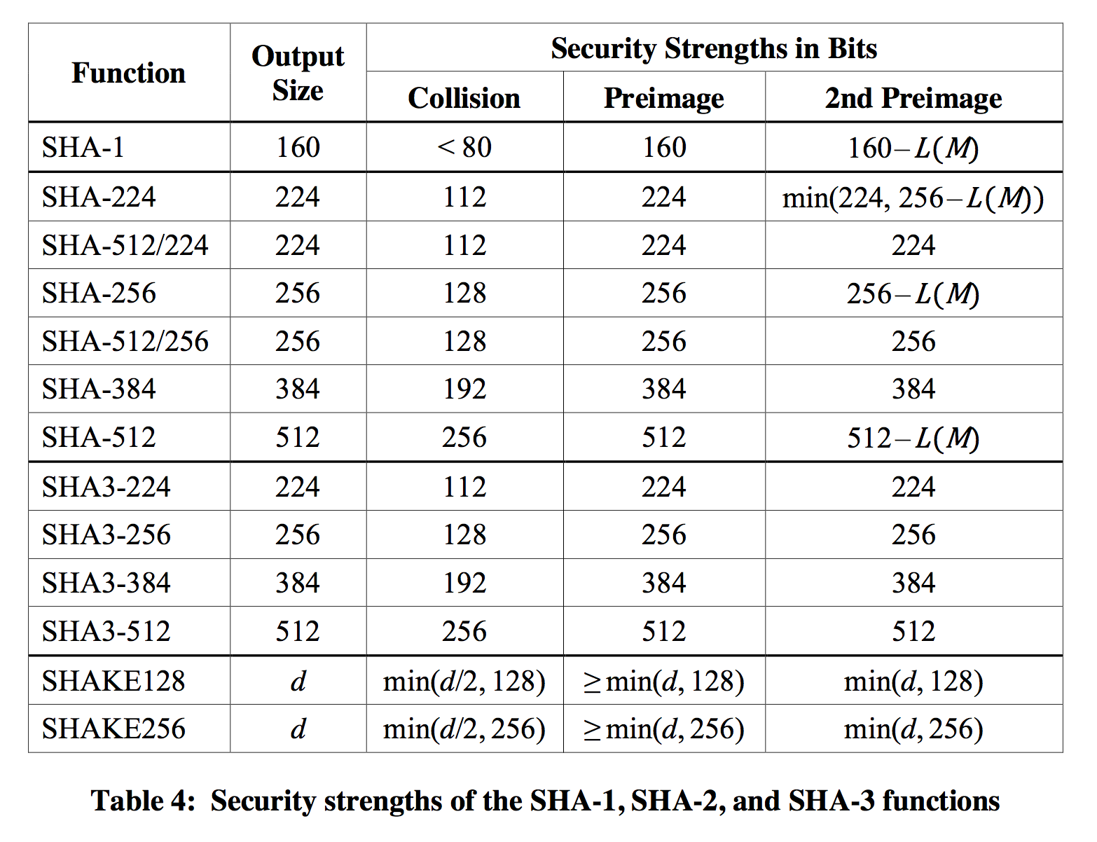

Slide 59
Summary
Hash functions are keyless
Applications for digital signatures and in message authentication codes
The three security requirements for hash functions are
one-wayness, second preimage resistance and collision resistance
MD5 and SHA-0 is insecure
Serious security weaknesses have been found in SHA-1
should be phased out
SHA-2 appears to be secure
May use SHA-512 and use the first 256 bytes
The winner of SHA-3 competition is KECCAK with more secure construction.

